Slide 1
Customer 1st
Client Quality Promise
Electrical consumption sensor ioo
Notes:
1

Slide 2
^{CLIENT QUALITY PROMISE}
^{Product designation}
Modifications history
CUSTOMER 1ST
Version N° | Modification object | Date | Validated by :
1 | Document creation | 03/07/2014
2
3
4
5
6

Slide 3
^{CLIENT QUALITY PROMISE}
^{Electrical consumption sensor}
Content
SCOPE OF APPLICATIONS…………………………………………………………………………. P.1
MAIN FUNCTIONALITIES…………………………………………………………………………... P.2
PRODUCT SPECIFICATIONS………………………………………………………………………. P.3
USE RESTRICTIONS…………………………………………………………………………………… P.4
RADIO PERFORMANCES…………………………………………………………………………… P.4
CERTIFICATIONS………………………………………………………………………………………. P.4
ERGONOMICS PRINCIPLES……………………………………………………………………….. P.5
INTEGRATION & INSTALLATION………………………………………………………………… P.6
WARRANTY……………………………………………………………………………………………… P.7
SUBSTITUTION……………………………………………………………………………………………… P.7
LOGISTIC INFORMATION………………………………………………………………………….. P.7
PACKAGING CONTENT……………………………………………………………………………… P.7
SUPPORT TOOLS & RECOMMENDATIONS………………………………………………… P.8
CRITERIAS RELATED TO THE PRODUCTS
CUSTOMER 1ST
OTHER CRITERIAS

Slide 4
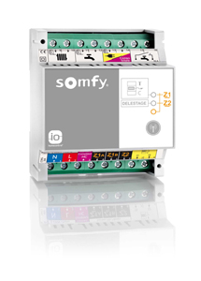
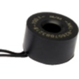
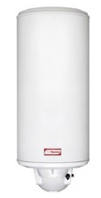
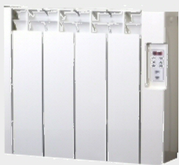
^{CLIENT QUALITY PROMISE}
^{Electrical consumption sensor}
This client quality promise concerns the electrical consumption sensor. Available from 01/07/2014 at LI.
CUSTOMER 1ST
Scope of application - 1
Compatibility with end-products
This product is designed to :
measure the electrical consumption of an installation
control hot water tank regarding smart grid (heure pleine/heure creuse)
control 2 heating zones of pilot wire electrical heatings (only the electrical heating version)

Slide 5
^{CLIENT QUALITY PROMISE}
^{Electrical consumption sensor}
Areas compatibilities
Compatible in all io-homecontrol® countries
For some features, electrical installation will have to use the french TIC standard
Controls’ compatibilities
CUSTOMER 1ST
Compatible with TaHoma box and Somfy box with activated io option ONLY
Main functionalities
There are 2 versions of the electrical consumption sensor, one for electrical heating (1822451 – 2401224) and one for heating pump (1822455).
Both version can be used with TaHoma or Somfy boxes. It allows to:
Measure the electrical consumption of an installation
Measure different sub-consumption like heating, domestic hot water and socket network
Control hot water tank regarding smart grid
Force the hot water tank
Only for electrical heating version:
Control 2 zones for pilot wire electrical heating
Set manually any of the 3 states: comfort – Eco – anti frost
Create and manage scenarios to run these 3 modes
Play the scenario manually with these 3 modes
Schedule the scenario to play automatically only for Eco and comfort modes

Slide 6
^{CLIENT QUALITY PROMISE}
^{Electrical consumption sensor}
Product specifications
Power supply Voltage 230 V
Frequency 50 Hz
Max current 16 A
Nb heaters max /
Interface 15 per zone
Class II
IP level IP 20
Temperature range Working 0°to +40° C
Protocol io-homecontrol®
Radio Frequency 868 MHz Tri Band / FSK
Radiated power +10dBm
Dimensions (mm) DIN Rail 35mm – 4 modules
Weight 150 g
Antenna Integrated antenna
Pilot wire Gifam standard – 6 orders
Certification and standards:
Safety of the user : EN EN60950-1 : 2006
Health of the user : EN50371 : 2002
Electromagnetic compatibility : EN61000-6-1: 2007_EN61000-6-3 : 2007_EN301 489-3 V1.4.1 : 2002_EN301 489-1 V1.8.1 : 2008
Radio Spectrum : EN300220-2 V2.1.2 : 2007_EN300220-1 V2.1.1 : 2006
CUSTOMER 1ST

Slide 7
^{CLIENT QUALITY PROMISE}
^{Electrical consumption sensor}
Use restrictions
To be used ONLY with TaHoma Box / Somfy Box with activated io option
To be used ONLY with 230V electrical heating with pilot wired regulation
Numbers max of heatings per interface: 15
Do not use with three-phase installation
The heating pump version can not control a heating pump. It can only receive a repartition signal to know when the heating pump is making hot water for heating or for domestic usage.
Optimized for electronical eletrical meter from EDF (with TéléInfo Client – TIC)
Mechanical electrical meter from EDF can only be used with one version:
electrical heating (1822451 – 2401224)
CUSTOMER 1ST
Radio performances
200 meters minimum in free-field condition
20m between 2 concrete walls
Certifications
Standard | Yes / No | Country
 |  | European Union
These products are compliant with CE certification only

Slide 8
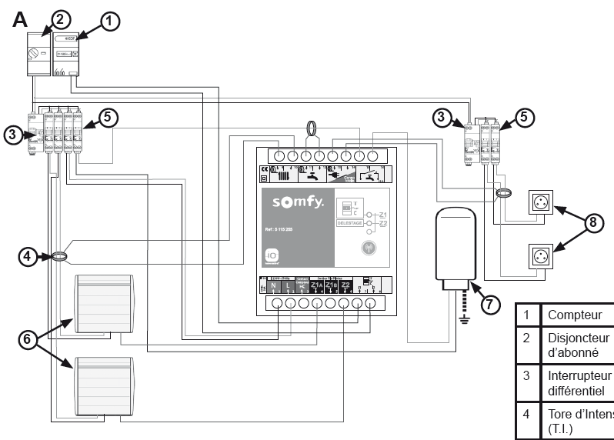
^{CLIENT QUALITY PROMISE}
^{Electrical consumption sensor}
Integration & installation
Cabling for electrical heating version and TIC
CUSTOMER 1ST

Slide 9
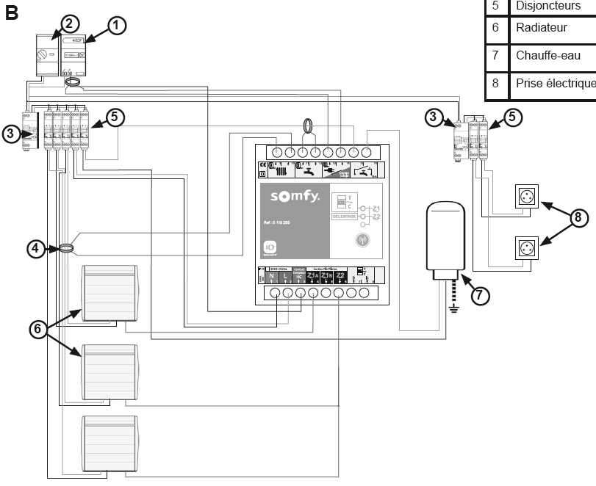
^{CLIENT QUALITY PROMISE}
^{Electrical consumption sensor}
Integration & installation
Cabling for electrical heating version and no TIC
CUSTOMER 1ST

Slide 10
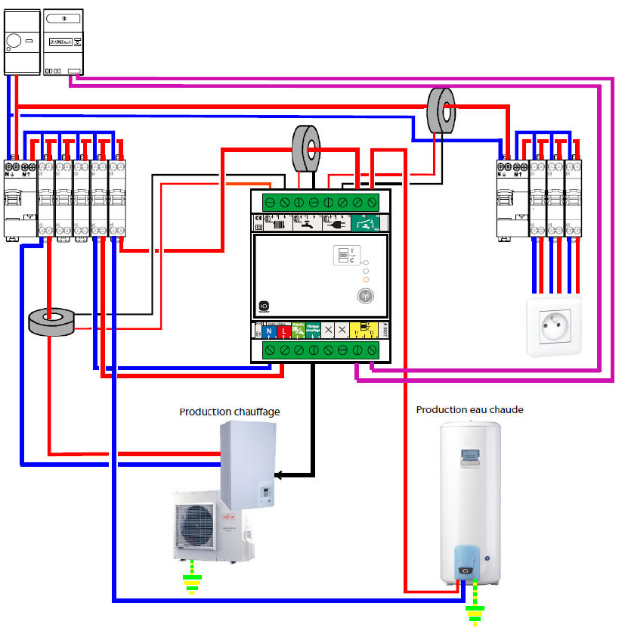
^{CLIENT QUALITY PROMISE}
^{Electrical consumption sensor}
Integration & installation
Cabling for heating pump version with 1 service (only heating)
CUSTOMER 1ST

Slide 11
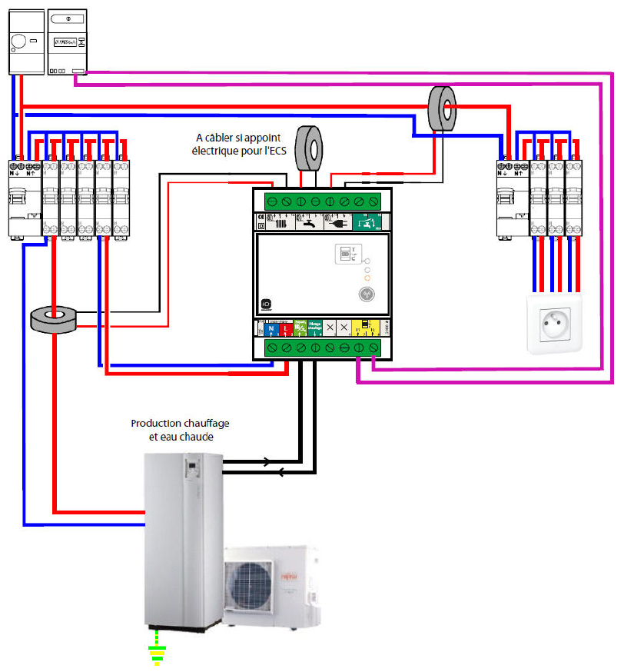
^{CLIENT QUALITY PROMISE}
^{Electrical consumption sensor}
Integration & installation
Cabling for heating pump version with 2 services (heating + hot water)
CUSTOMER 1ST

Slide 12
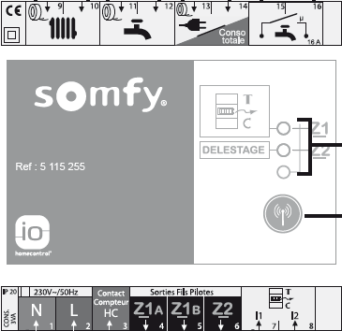
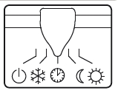
^{CLIENT QUALITY PROMISE}
^{Electrical consumption sensor}
Ergonomics principles
Pairing
Login into the TaHoma interface
Go to settings → io equipments → sensors and choose the electrical sensor to be paired.
Press once the button then within 5s, press again the button for 4s and follow the steps displayed on the screen.
CUSTOMER 1ST
Prog button
Heating settings
Select FP (= pilot wire ctrl) on the heating switch

Slide 13
^{CLIENT QUALITY PROMISE}
^{Electrical consumption sensor}
Ergonomics principles
Pairing Hot water tank
Pairing pilot wire zones
Hot water is automatically added when adding a sensor and it appears in “io equipments” menu
If it has been deleted, it can be recovered through the io equipment “adding” procedure then “ignore”.
The 2 zones for pilot wire electrical heating can be discovered through the “io equipment” adding procedure then “ignore”
CUSTOMER 1ST

Slide 14
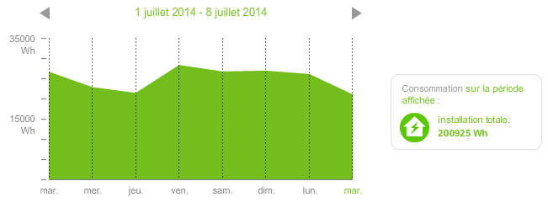
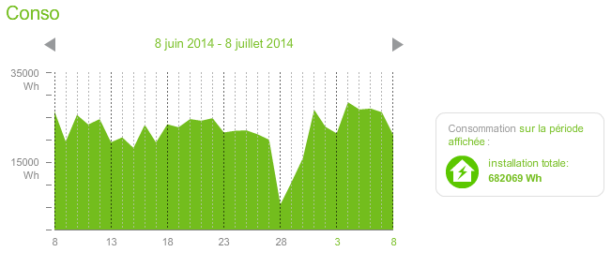
^{CLIENT QUALITY PROMISE}
^{Electrical consumption sensor}
Ergonomics principles
HMI
Different sensors are created regarding the different consumptions:
Miscellaneous
Heating
Domestic hot water
Socket
Total
CUSTOMER 1ST
To display the consumption of one sensor, you just have to click on it:
Consumption is available for one week, one month, or 1 year.

Slide 15
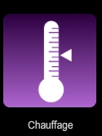
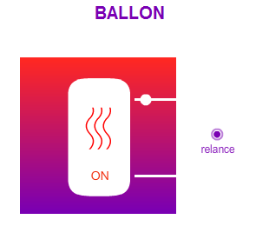
^{CLIENT QUALITY PROMISE}
^{Electrical consumption sensor}
Ergonomics principles
HMI
The hot water tank is set under heating family
CUSTOMER 1ST
Icon looks like a tank
During “heures pleines”, the hot water tank is not activated.
With TaHoma there is a possibilty to force this activation.

Slide 16
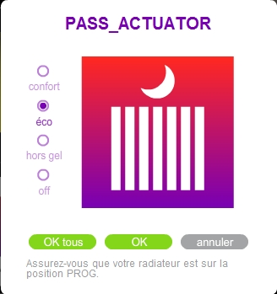
^{CLIENT QUALITY PROMISE}
^{Electrical consumption sensor}
Ergonomics principles
HMI
The pilot wired interface is set under heating family
CUSTOMER 1ST
Icon looks like heating
When opening the interface, it is possible to check any of the 3 states:
Confort
Eco
Anti frost

Slide 17
^{CLIENT QUALITY PROMISE}
^{Electrical consumption sensor}
Ergonomics principles
MODE MANAGEMENT
Manually all mode can be triggered.
Within a scenario only Comfort and eco can be set.
CUSTOMER 1ST
Modes that can set manually and in a manual scenario | Modes that can be set in a schedule or programmed scenario
Comfort | Comfort
Eco | Eco
Anti frost | -

Slide 18
^{CLIENT QUALITY PROMISE}
^{Electrical consumption sensor}
Ergonomics principles
MODE MANAGEMENT
If the pilot wired interface is shutdown (mains cut off), when the mains comes back it will return to it initial state except if it was in OFF state.
Actually, off state can occur due to unballasting. To prevent to stop definitively the heating system after unballasting, the pilot wired interface will so never turn off after a power cut off → on.
CUSTOMER 1ST
Le OFF doit disparaître avec le 2.0
Trop compliqué pour le end-user cette histoire de dernier mode activé…
Initial state | Cut off | New state
Confort |  | Confort
Eco |  | Eco
Anti frost |  | Anti frost
Off |  | Last state prior to off

Slide 19
^{CLIENT QUALITY PROMISE}
^{Electrical consumption sensor}
Warranty
2 years international warranty
Substitution
No substitution
CUSTOMER 1ST
Logistic information
The electrical consumption sensor io is available at LI in UNIT packaging.
Available languages : French
Distribution channel: Pro and DIY
Page catalogue
Référence | Nom |  | Contenu du pack | Marque
2401224 | Electrical consumption sensor Electrical heating | DIY | 1 interface + notice DIY + 3 tores | Somfy
1822451 | Electrical consumption sensor Electrical heating | Pro | 1 interface + notice Pro + 3 tores | Somfy
1822455 | Electrical consumption sensor Heating pump | Pro | 1 interface + notice Pro+ 3 tores | Somfy
Packaging content
Individual packaging
Box includes:
1 Sensor
3 Tores
1 Leaflet

Slide 20
^{CLIENT QUALITY PROMISE}
^{Electrical consumption sensor}
Support tools and recommendations
Available documents throughout the product life cycle tool:
Installation leaflet
Technical datasheet
CUSTOMER 1ST

